Slide 1
Phenotype Based biomarker validation and target identification.
Ronin Dx/Tx
Rational Development of Cancer Diagnostics and Therapeutics.
BUSINESS PLAN
Raj K Batra M.D.
Founder, President
241 S. Lapeer Drive; Beverly Hills, CA 90211

Slide 2
“The first (most important) rule in being a wise leader is to accurately define the problem” Confucius

Slide 3
The Problem
If 20 people were diagnosed with lung cancer today, only 3 would be alive in five years.
170,000 people die of lung cancer each year (more than breast and prostate cancers combined), and millions of current and ex-smokers are at risk.
>$13 billion annual Therapeutics market.
Why do people die of lung cancer?

Slide 4
Why people with lung cancer die?
because it is generally recognized too late
because we cannot predict how aggressive the disease is at the time of diagnosis
because we are not very good at treating aggressive disease
Whereas many have invested a lot of intellect and money into determining how to best diagnose lung cancer early (#1 above), we are focused on reason numbers 2 and 3.

Slide 5
Goals
Define disease aggression (predict prognosis) at the time of diagnosis.
Use the same information to figure out better ways to treat the aggressive disease (Develop rational combinatorial therapies).

Slide 6
How do we diagnose, prognosticate AND treat aggressive disease in a single step?
We must start studying cancer in exactly the opposite way from which it has been studied for the last 5-6 decades.

Slide 7
For several decades, we have inaccurately defined cancer as exactly the opposite of what it truly is…
Monoclonal Disease
My hypothesis is that cancers are actually diseases of genetic/epigenetic hypermosaicism, as opposed to diseases of monoclonality.
Genetic/Epigenetic Hypermosaicism

Slide 8



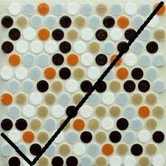
Cancer has been studied as a monoclonal disease (which is wrong) as opposed to a mosaic

Slide 9
Thus, the Current Standard of Care for diagnostics and therapeutics are inadequate?

Slide 10
Moreover, Emerging Diagnostic/Targeted Treatment Approaches Are Inadequate?
Current Platform for prescribing “Targeted Therapy.”
Lung cancer is dxed. with sample biopsy.
“Driver mutations” (genetic abnormalities that are inferred to “drive” the disease) are identified, and “targeted” therapy is prescribed.
Currently, there is “effective targeted therapy” for EGFr-mutated and EML-ALK4 fusion lung cancers.
“Companion diagnostics” limit “Targeted Tx.” to small selected patient subsets, in whom it is not durably effective.

Slide 11
Targeted Treatment: Caveats
The prevailing targeted treatment approach assumes:
1) that the sample of tumor from which a genetic (or marker) profile is determined is wholly representative of the entire tumor.
and
2) that the “driver” mutations in the sample can reliably predict (prognosticate) the tumor behavior.

Slide 12
BOTH of these assumptions are incorrect.

Slide 13


Targeted Tx: Sampling Caveat (1) (the concept that “all tumor cells are the same” is wrong)
Because cancers are diseases of (hyper)mosaicism, the information from biopsy samples can vary depending on which location is sampled

Slide 14
Targeted Tx: Inference Caveat (2) (the concept that “driver mutations predict tumor behavior” is also wrong)
There is a myriad of acquired genetic mutations in individual tumors, and they can vary from one tumor cell to another.
Thus, it is not clear which genetic/epigenetic abnormalities are the key “drivers of disease”?

Slide 15
Targeted Tx: Inference Caveat (2) (the concept that “driver mutations predict tumor behavior” is also wrong)
It is quite plausible that EACH CANCER CELL in a tumor is (genetically/epigenetically) different from its neighbor.
Again, cancer is a disease of hypermosaicism, not monoclonality.
We have developed (and patented) a novel approach to study it from that perspective.

Slide 16
Refining “Personalized” Therapy for Cancer
We simply propose a shift towards the discovery of key disease “drivers”.
We Propose to Target cancer Pathophysiology, NOT pathogenesis.
Instead of targeting individual “pathogenetic” mutations, we target lethal behavioral properties (tumorigenesis, metastasis, and drug resistance) of lung cancer cells.

Slide 17
Current Paradigm
Our New Paradigm
Individual with tumor in lung
Individual with tumor in lung
Extract and Culture Biospecimen
Sample to extract DNA/RNA/Protein Biomarker
Live-sort tumor cells on basis of biomarker expression
Identify Candidate
Drivers of Disease from Sample
Directly associate biomarker with behavioral phenotype
Deep sequence test and controls to identify real drivers of a disease-phenotype.

Slide 18
Current Team
Active Collaborations
UCLA-Pathology: J Rao; D Rao, N Rao;
UCLA bioinformatics: Matteo Pellegrini
USC: D Warburton.
Boston University: D Kotton.
UCLA/VAGLAHS
Raj K Batra
Saroj K Basak
MS Veena
Scott Oh
Eri Srivatsan

Slide 19
The team leader was the Chief Translational Architect in UCLA Lung Cancer Research Program (1998-2007).
“Translated” immuno-genetic therapy into the clinical setting.
develop and implemented research paradigms to file an Investigational New Drug (IND) Application.
Obtained regulatory approvals from NIH-OBA and FDA-CBER for “A Phase I Trial of CCL-21 Gene Modified Dendritic Cells in Non-Small Cell Lung Cancer.”
Obtained the clinical grade (cGMP-grade) adenoviral vector through NIH-RAID.

Slide 20
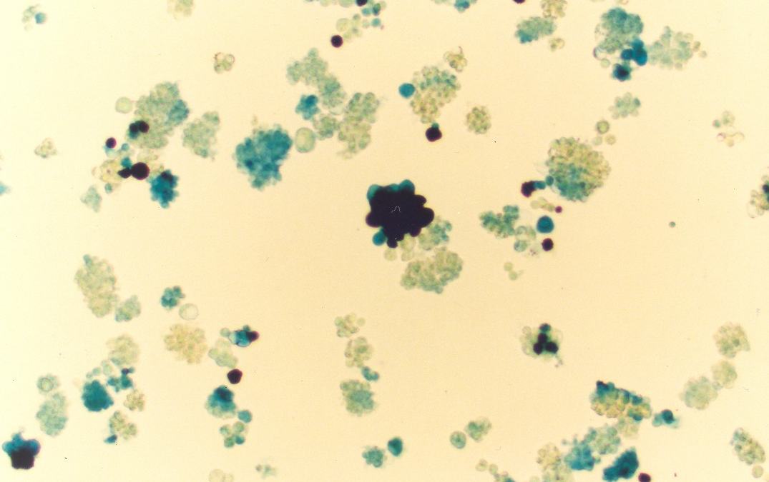
Determined that Ad-gene transfer into primary tumors display intra-tumoral heterogeneity in transduction. Estimated MOI 1000, MPE-tumor primary culture

Slide 21
Interpretation: the receptors and processes that are responsible for mediating Ad-gene transfer into target cancer cells are not uniform in a clinical setting.
Current Experimental cancer cell models severely underestimate intra-tumoral heterogeneity.
We use them because “they work” in getting research-funding. But in doing so, we lose disease complexity, and consequently, predictability of effect

Slide 22
Starting in 2006, we began modeling Intra-tumoral Heterogeneity
Hypothesis: An individual tumor is really a “combination of diseases” [functionally distinct cancer cells due to underlying genetic/epigenetic and/or TME-associated (signaling-mediated) differences].
Some cell subsets are inherently more capable than others of aggressive (lethal) behavioral properties (tumorigenic potential, invasion/metastases, or drug resistance).

Slide 23
Modeling Intratumoral Heterogeneity
Question 1: Are cells which label for Cancer Stem Cell-biomarkers actually present in clinical biospecimens?
Answer 1: Yes. You are likely to find a wide variety of “CSC” biomarkers in individual biospecimens.
Basak et al; PLoS-ONE 2009.

Slide 24
Modeling Intratumoral Heterogeneity
Question 2: Can one primarily culture clinical biospecimens and maintain CSC-biomarker expression?
Answer 2: Yes, and you can live sort MPE-primary cultures based on that expression.
Basak et al; PLoS-ONE 2009.

Slide 25
Modeling Intratumoral Heterogeneity
Question 3: Can one sort behaviorally aggressive cancer cells from clinical biospecimens ?
Answer 3: Yes, and one can meet the current experimental standard for isolating “lung cancer stem cells”.
Basak et al; PLoS-ONE 2013.

Slide 26
Modeling Intratumoral Heterogeneity
Question 4: Can one identify specific molecular targets from behaviorally aggressive cancer cells in clinical biospecimens ?
Answer 4: Yes. miR34a is a therapeutic target in the aggressive (high tumorigenic potential) CD44^{hi} cell subsets in lung cancer.
Basak et al; PLoS-ONE 2013.

Slide 27
“There are two kinds of success-initial and ultimate” Churchill I suggest that we are at the beginning of the end for a better understanding and treatment of lung cancer, but are we brave enough to fix a better course for the future?

